Slide 1
The Contemporaries Postmodernism
1939-Present

Slide 2
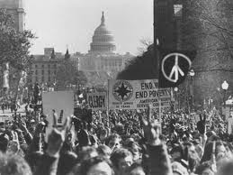
Background Historical, Political, Social
Wars: WWII, Cold War, Korean, Vietnam
Atomic bomb
Nuremburg Trials
Anti-communist sentiment
Red Scare
McCarthyism
Space Race
Civil Rights Movement
Martin Luther King Jr.
Little Rock Nine
JFK assassinated
Tension with Middle East
Iranian Hostage Crisis
9/11

Slide 3
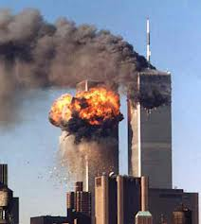
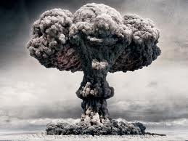
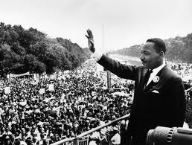
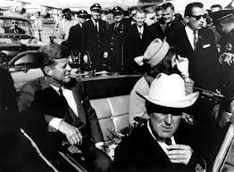
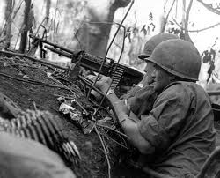

Slide 4
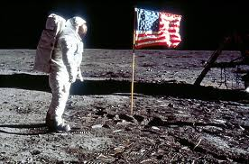
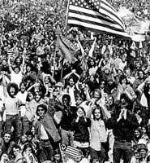
‘Merica!

Slide 5
Characteristics of Postmodern Literature
Allows for multiple meanings and multiple worlds
Literal, figurative, dreamlike worlds
Nontraditional forms and structure
Narrator and characters may tell different versions
Plot does not always follow a linear form
Comments on itself
Comment, criticize, and contradict itself which encourages readers to make their own interpretations
Intensely personal
Cultural diversity
Blends fiction and non-fiction
Uses the past fearlessly

Slide 6
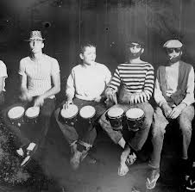
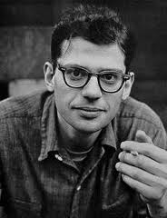
Postmodern Poetry
Beat Generation
“Beatniks”
Alternative forms
Poetry slams
Jazz performances
Late night coffee houses
Anti-conformity (new attitudes and voices)
Confessional School of Poetry
Blunt and personal poems about the poet’s
private life

Slide 7
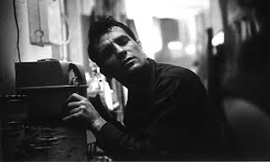
Bowery Blues
Jack Kerouac
The story of man Makes me sick Inside, outside, I don't know why Something so conditional And all talk Should hurt me so. I am hurt I am scared I want to live I want to die I don't know Where to turn In the Void And when To cut Out
For no Church told me No Guru holds me No advice Just stone Of New York And on the cafeteria We hear The saxophone O dead Ruby Died of Shot In Thirty Two, Sounding like old times And de bombed Empty decapitated Murder by the clock.
Okay. Quit. Mad. Stop.

Slide 8
Nonfiction
Experiment with form
Blend nonfiction with fictional elements
Vivid characters
Suspense
Style/Tone

Slide 9
The Breaking Point: On the cusp of death, sanity, and injustice
Social Injustice
Civil Rights
Sanity
“I saw the best minds of my generation destroyed by madness, starving hysterical naked,” Allen Ginsberg
Pressure
Relationships
Mental Health
Death
Success/Failure

